Slide 1
WELCOME TO THE PRESENTATION

Slide 2





CASE-01
UNIHOST CORPORATION

Slide 3
ECONOMIC ANALYSIS
Economy is in expansion cycle that usually lasts for 10-12 years.
Government is lowering interest rate which indicates expansionary monetary policy.
UNIHOST has a better record than industry average.
Hotel industry is positively related with the economic cycle.

Slide 4
Porters 5 force model
Bargaining power of suppliers (High)
For this reason the company had to pay more for its primary raw material.
Bargaining power of Buyers (High)
Customer have the power over the product and service provider of this industry.
Threat of existing competitors (HIGH)
Compete for the same customers daily and for the retention of the existing customers.
Threat of new entrants (Low)
Higher level of Fixed Costs.
Substitute Product
( High)
Switching cost is significantly lower for the customers.

Slide 5
Ratio Analysis
Key Ratios: | 1995 | 1996 | 1997
Operating profit margin | 7.3% | 7.2% | 12.7%
Net profit margin | 5.1% | 3.8% | 7%
Revenue growth rate |  | 2.01% | 8.04%
Return on equity |  |  | 8.88%
Net interest coverage | 3.42 | 3.44 | 6.53

Slide 6
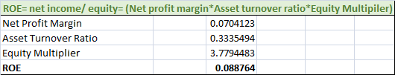
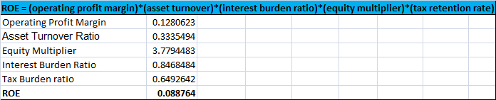
DU pont analysis

Slide 7
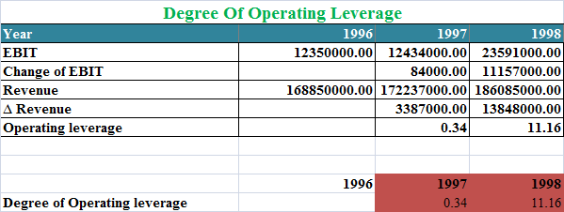
Risk Analysis (Business Risk)
BUSINESS RISK
Operating Income Variability | 40%
Sales Variability | 5%

Slide 8
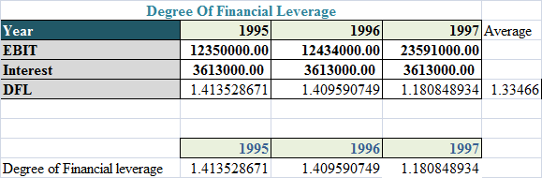
Financial Risk
Higher the degree of debt use, higher the financial risk.

Slide 9
Z SCORE MODEL
Working Capital/Total Asset | 0.0099
Retained Earnings/Total Asset | 0.12
EBIT/Total Asset | 0.042
Market Value of Equity/Book value of debt | 0.36
Sales/Total Asset | 0.34
Z Score | 0.88
Distress Zone
Z = 1.2X1 + 1.4X2 + 3.3X3 + 0.6X4 + 1X5
Value is lower than 1.81. So the company is in Distress zone. According to the category firm has higher bankruptcy cost in near future.

Slide 10
ASSUMPTIONS
Income tax | 35%
Capital expenditure | 3.5% of revenue each year
Terminal growth rate | 3%
Depreciation | 2.5%(straight line method)
Occupancy rate taken as the proxy variable of return in order to measure risk(beta).

Slide 11
PROBLEM STATEMENT
Identifying the appropriate strategy as to how UniHost corporation can manage the growth so that the value of the shares is maximized.

Slide 12
Alternatives
Issue new equity
Issue convertible debentures
Issue high yield debt

Slide 13
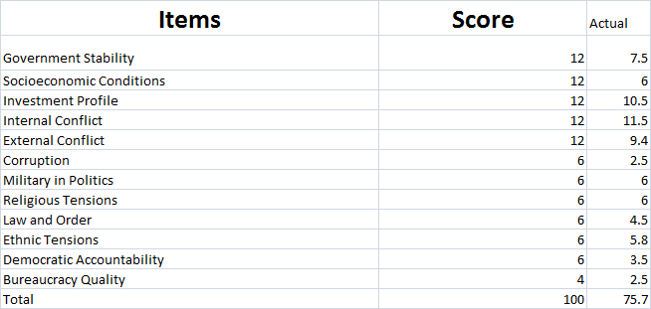
Country risk analysis according to ICRG Methodology (Political Risk)

Slide 14
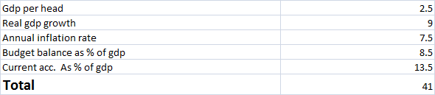
Country risk analysis according to ICRG Methodology (Economic Risk)

Slide 15
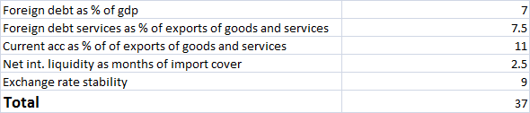

Country risk analysis according to ICRG Methodology (Financial Risk)
We added 10 basis point to the WACC to compensate for this low risk of Caribbean region.

Slide 16
ALTERNATIVE-1 (Issue New Equity )
Enterprise Value | 897,212,158.12
Add:Cash and Marketable Securities | 6,051,726.39
Less: Interest Bearing Debt | 412,890,000.00
Equity Value | 505,373,884.51
Total number of shares Outstanding | 38,944,681.84
Value per Share | 12.9767
WACC is 5.89 % if the company issues new equity
Case 1-Group 63. xlsx

Slide 17
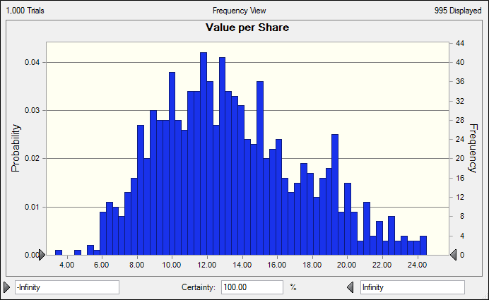
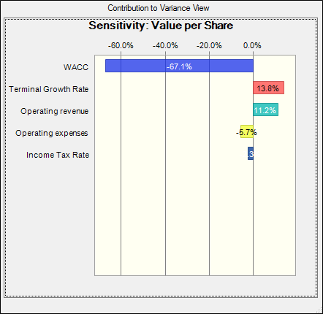
(ALTERNATIVE 1): NEW ISSUE SIMULATION

Slide 18
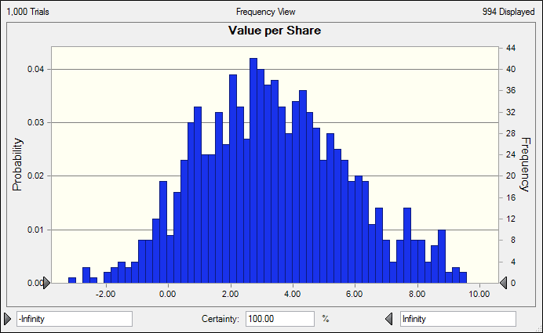
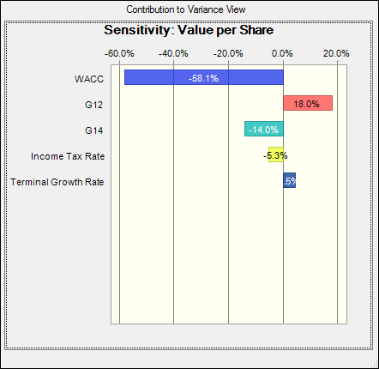
ALTERNATIVE -02 (Convertible Debentures Simulation)

Slide 19
ALTERNATIVE-03 (High yield Debt Issues)
Enterprise Value | 407,988,602.25
Add:Cash and Marketable Securities | 6,051,726.39
Less: Interest Bearing Debt | 412,890,000.00
Equity Value | 1,150,328.64
Total number of shares Outstanding | 37,299,945.00
Value per Share | 0.0308
As debt level has increased WACC has also increased from 7.12% to 8.46% after adjusting for risk premium.
Case 1-Group 63. xlsx

Slide 20
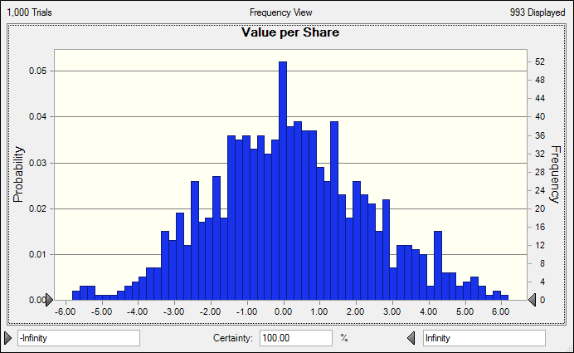
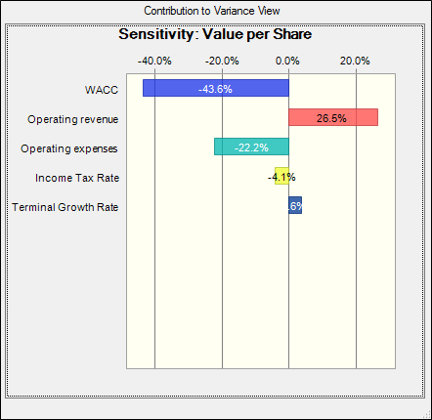
ALTERNATIVE-03 (High yield Debt Issues)

Slide 21
Recommendation
Alternatives | Value Per Share
Equity Issue | 12.97
Convertible Debentures Issue | 3.3083
High yield Debt Issue | 0.0308
The firm should go for Equity Issue as intrinsic value of the firm is higher among the three alternatives. The firm is familiar with this type of issuance and has a “POP” status too.

Slide 22
QUERIES????

Slide 23
THANK YOU

